Slide 1

DIABETES PREDICTION ASSESSMENT

Slide 2
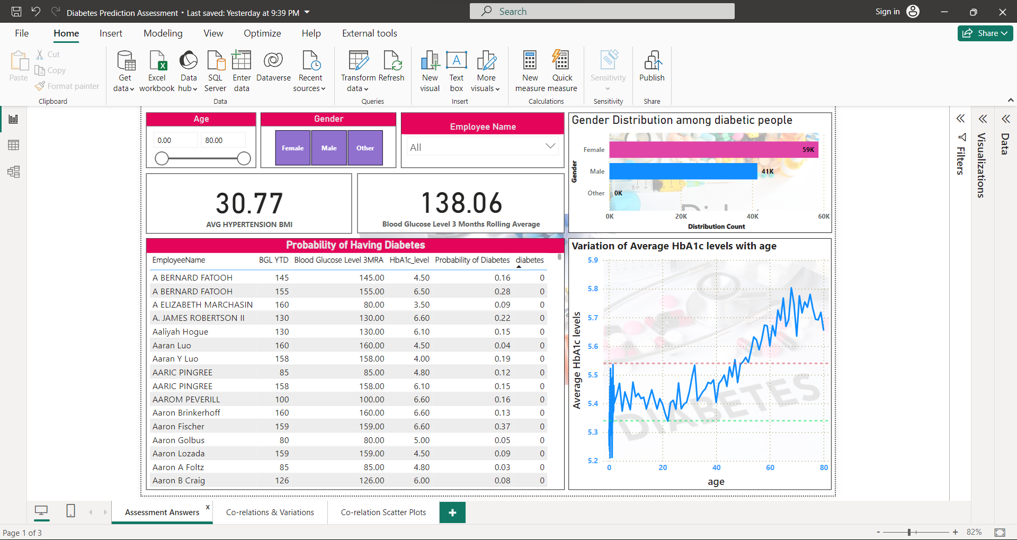

Slide 3
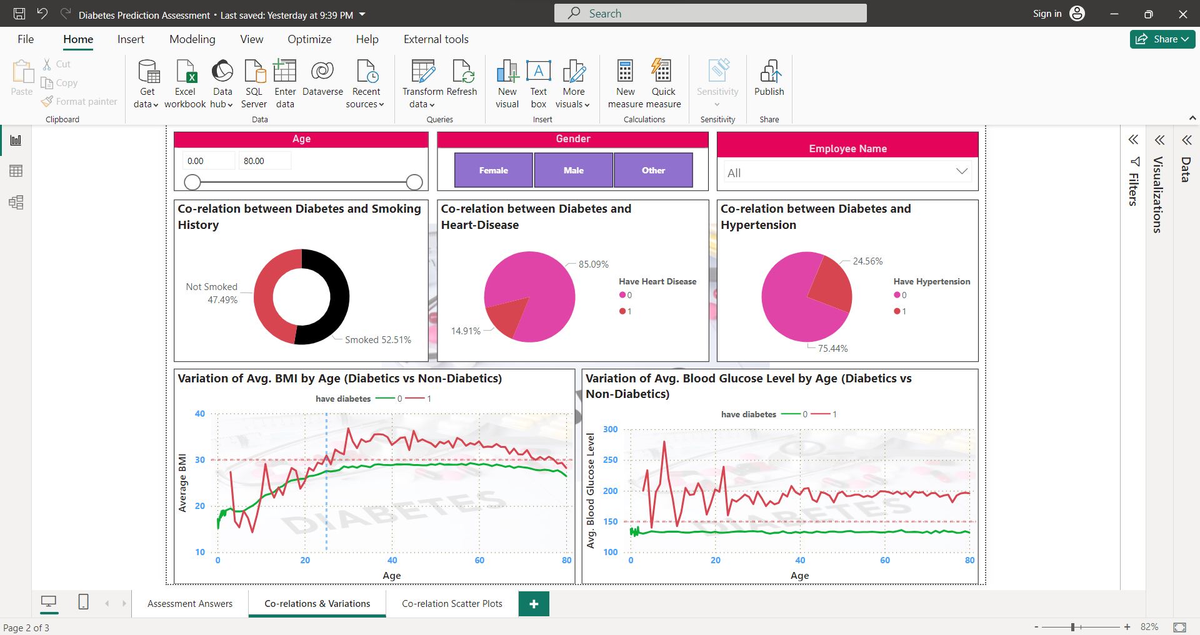

Slide 4
